Slide 1
Test-Driven Development
Testing before coding

Slide 2
What is Test-Driven Development (TDD)?
It's simply unit testing but the test is written first
Typically done with two people (eXtreme Programming – XP)

Slide 3
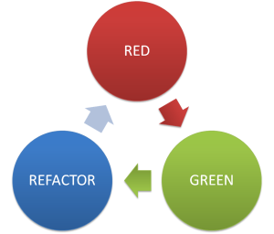
Write some test code: red
Write some app code: green
Refactor the test until complete

Slide 4
Advantages of TDD
Avoids code bloat
Generally faster development
Saves cost over the entire project

